Slide 1

CMA CGM WELLNESS STATISTICS

Slide 2
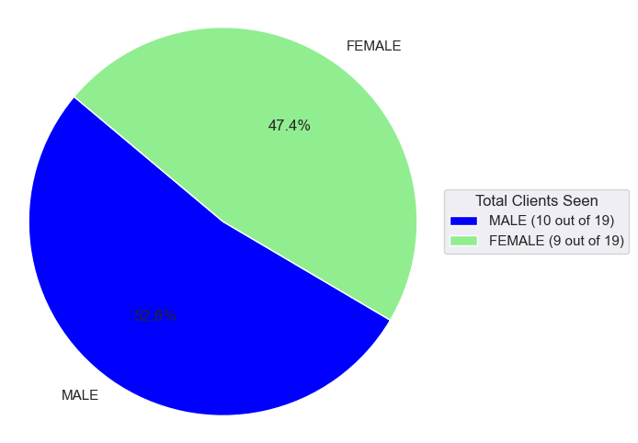
Total Number of Clients seen

Slide 3
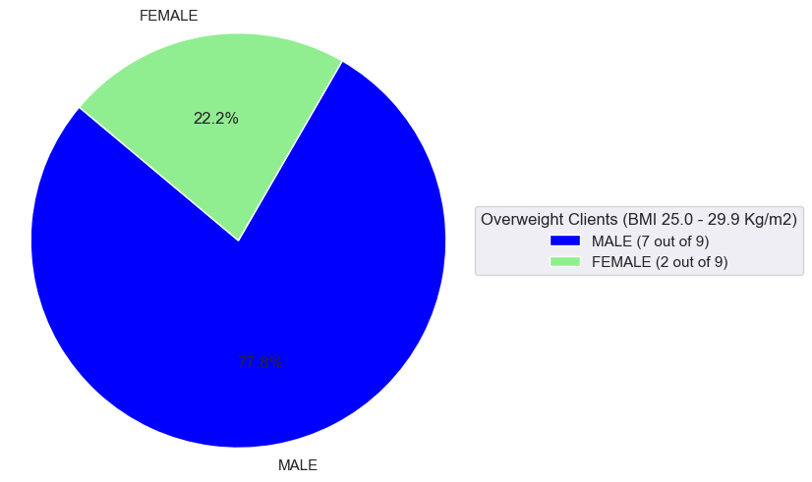
OVERWEIGHT (BMI OF BETWEEN 25.0 - 29.9 Kg/m2)

Slide 4
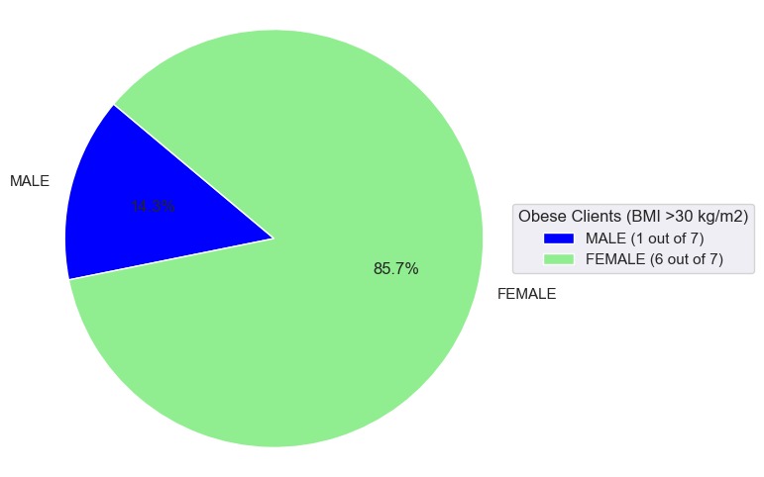
OBESE (BMI >30 kg/m2)

Slide 5
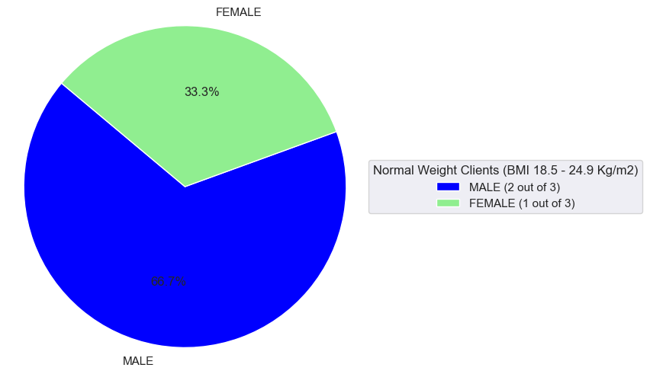
NORMAL WEIGHT (BMI BETWEEN 18.5 - 24.9 Kg/m2)

Slide 6
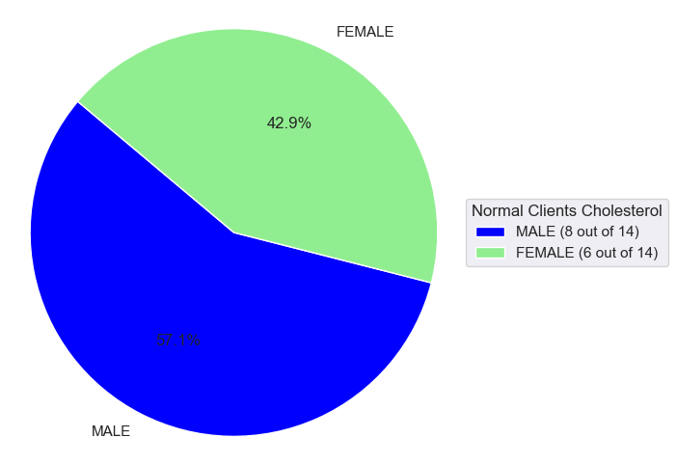
TOTAL CHOLESTEROL-NORMAL

Slide 7
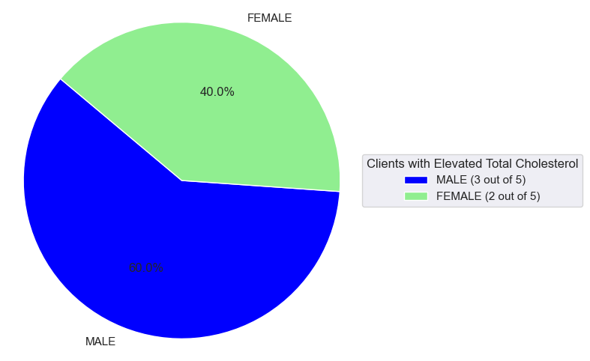
ELEVATED TOTAL CHOLESTEROL

Slide 8
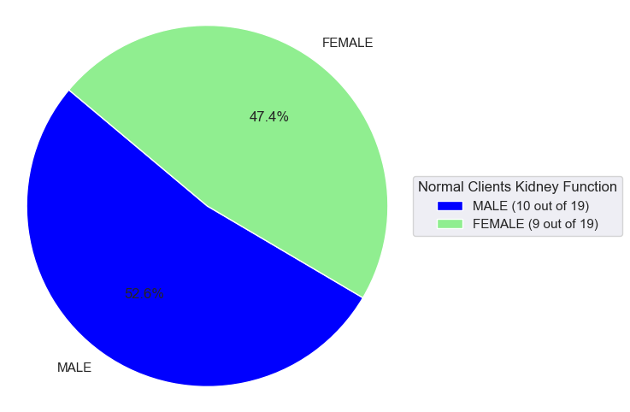
KIDNEY FUNCTION- NORMAL

Slide 9
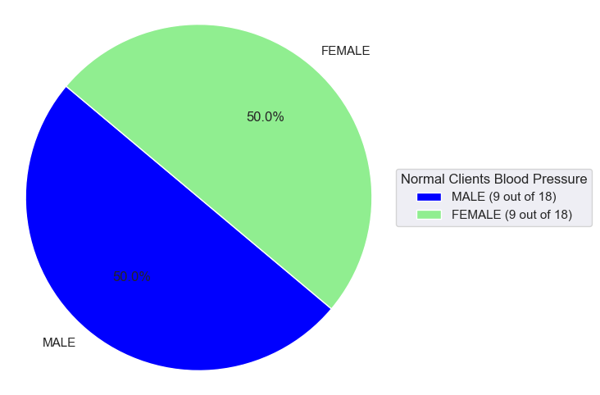
BLOOD PRESSURE-NORMAL

Slide 10
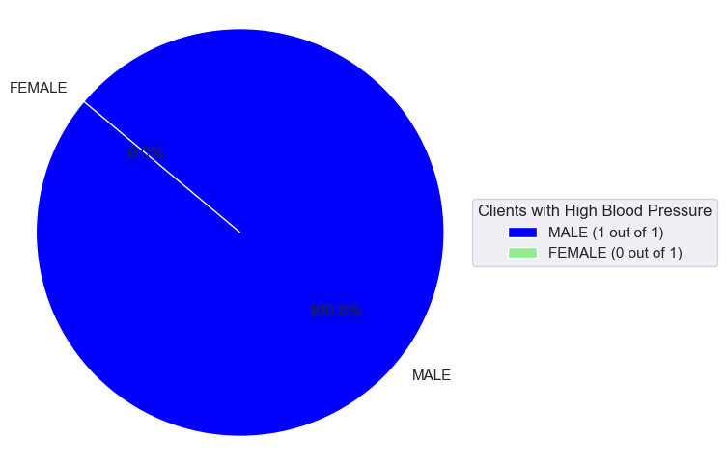
HIGH BLOOD PRESSURE

Slide 11
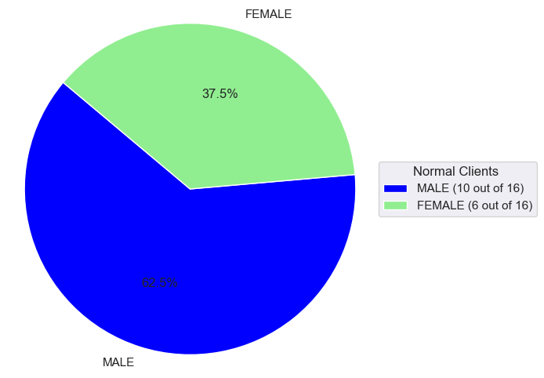
URINARY TRACT INFECTION-NORMAL

Slide 12
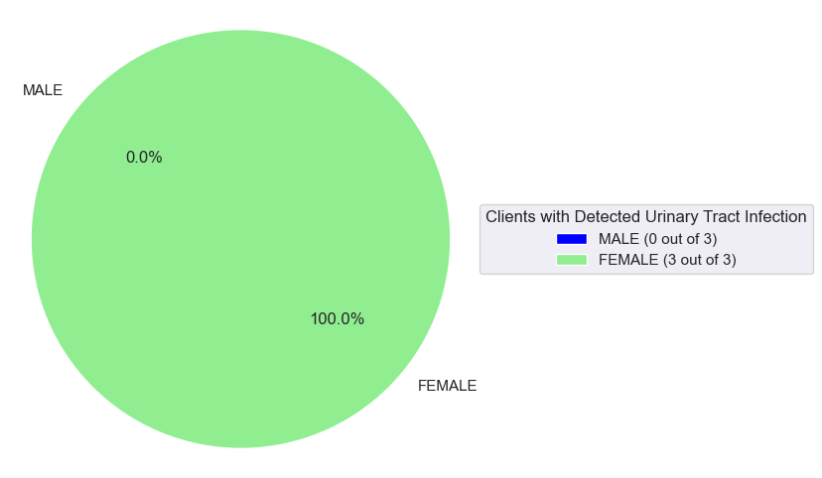
DETECTED URINARY TRACT INFECTION

Slide 13
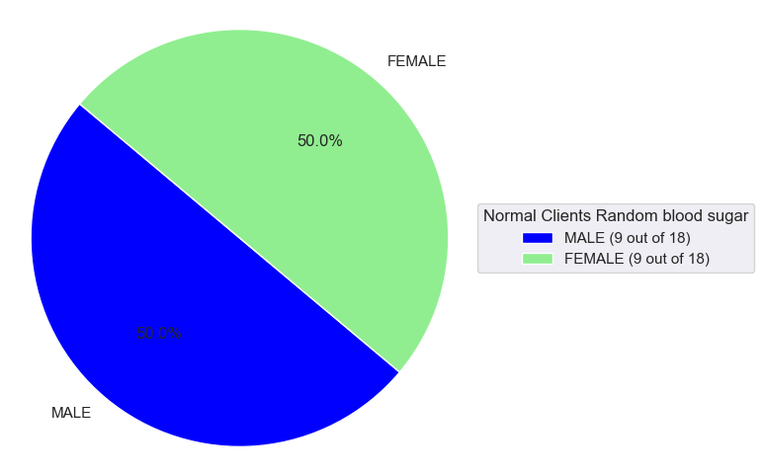
RANDOM BLOOD SUGAR-NORMAL

Slide 14
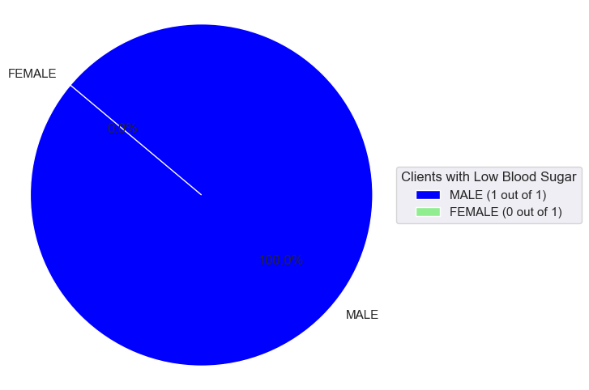
LOW BLOOD SUGAR

